Slide 1








Q-Boss 007
Use Case: Optimal Resource Scheduling – “Unit Commitment”
September 2023

Slide 2

Use Case Defined
The electric grid is going through a transformation with several stressors including increased connectivity (microgrids, rooftop solar, etc.), push for “electrification”, increasing extreme weather conditions, regulatory policies, etc.
Electrical planners and operators need to be able to schedule available resources to meet the dynamic and fluctuating demand, also called the “unit commitment” problem.
“unit commitment” problem is a multi-period, mixed-integer linear optimization problem
Goal is to minimized the total cost of dispatch that meets the electricity demand taking into consideration the grid as well as resource constrains.

Slide 3
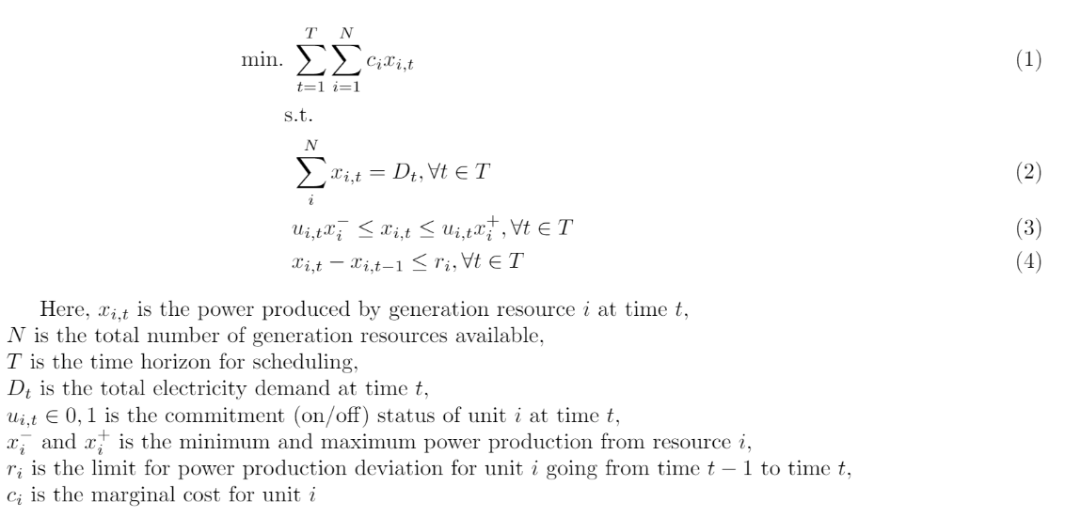
Breaking Down the Problem
Problem Definition:
(1) Minimize the total cost of power produced over a period T.
(2) Meet the total energy demand for each hour
(3) Satisfy each generating unit’s capacity constraints
(4) Meet the ramping constraints

Slide 4
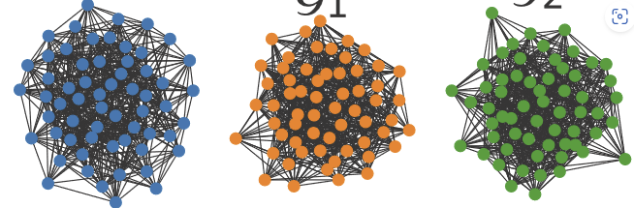
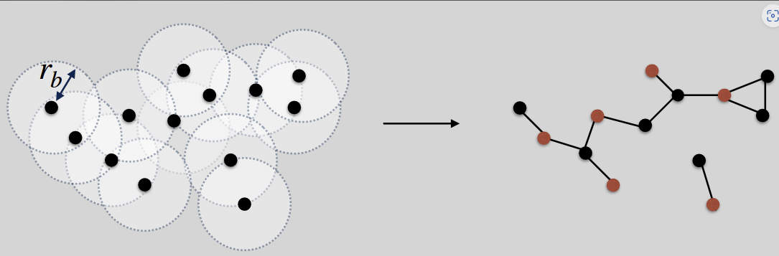
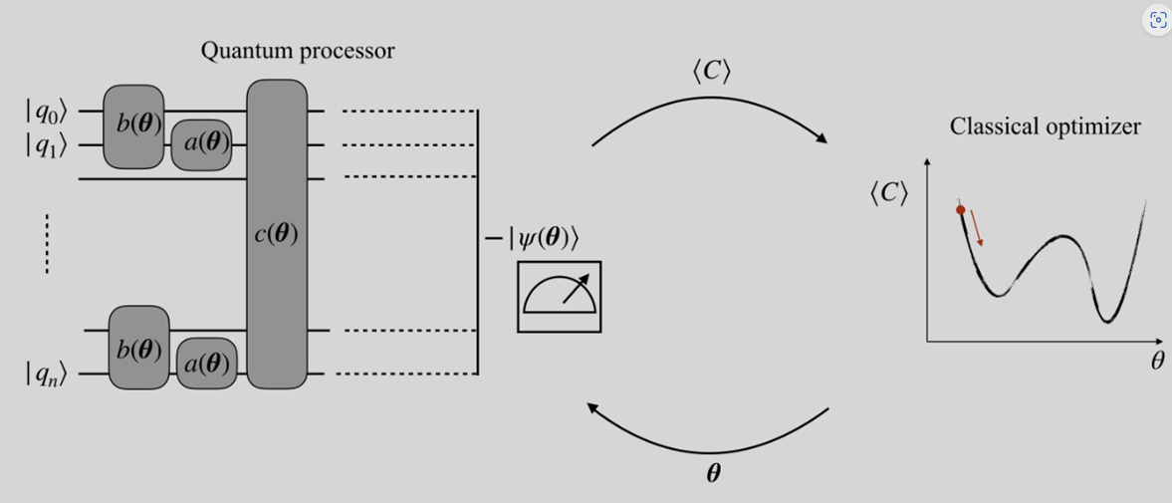

Quantum Computer Advantage
Exploring this optimization use case, we quickly realized that the best approach is to utilize a hybrid classical/quantum solution.
As the number of generating resources (X_{i}) increase the optimization of these resources (a many-to-many connected graph) becomes an exponentially hard (NP hard) and challenging problem to solve for even the fastest classical computers.
Breaking down the problem into various components, we decided that the optimization module can utilize Quantum Computing’s efficiency and speed for calculating the minimization of the cost for a given set of parameters.
We utilized Quadratic Unconstrained Binary Optimization (QUBO) algorithm on Pasqal’s Pulser analog mode for this exercise:

Slide 5



Slide 6
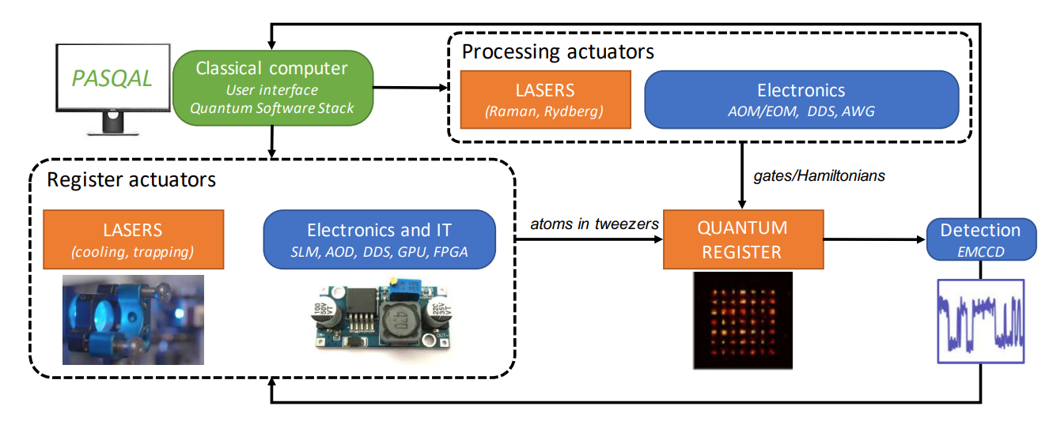
Pasqal

Slide 7
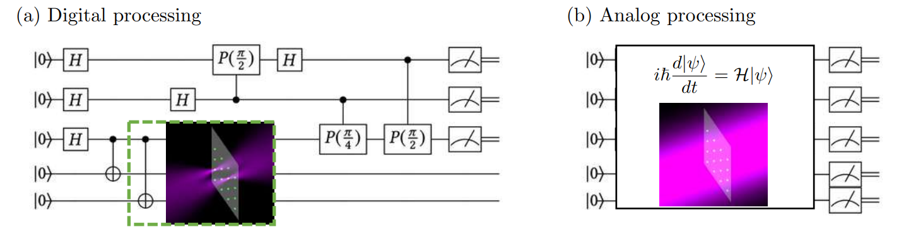
Analog vs Digital Quantum Computing

Slide 8
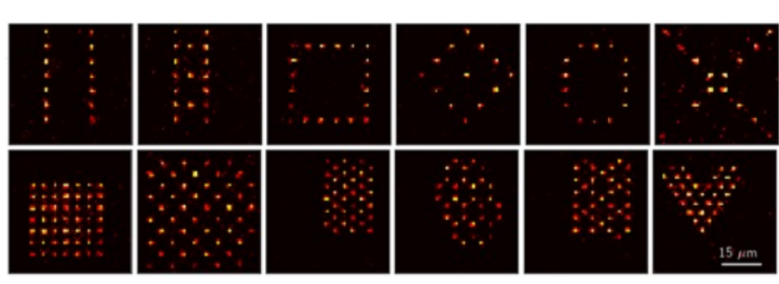

Slide 9
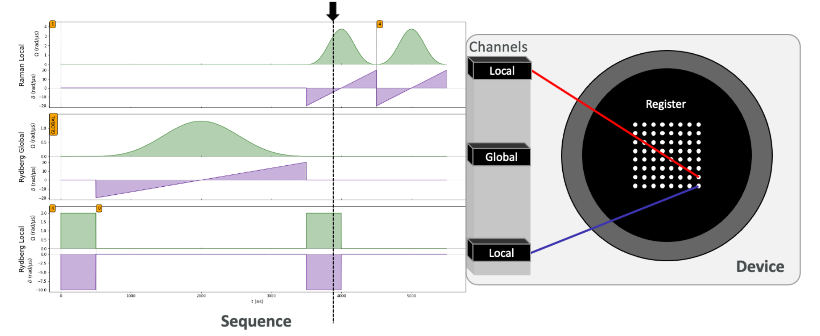
Pulser
Open-Source Python Package
Programming Neutral Atom Devices at the Pulse Level

Slide 10
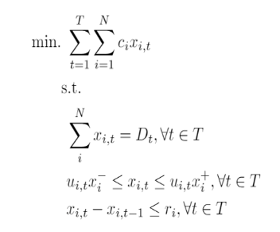
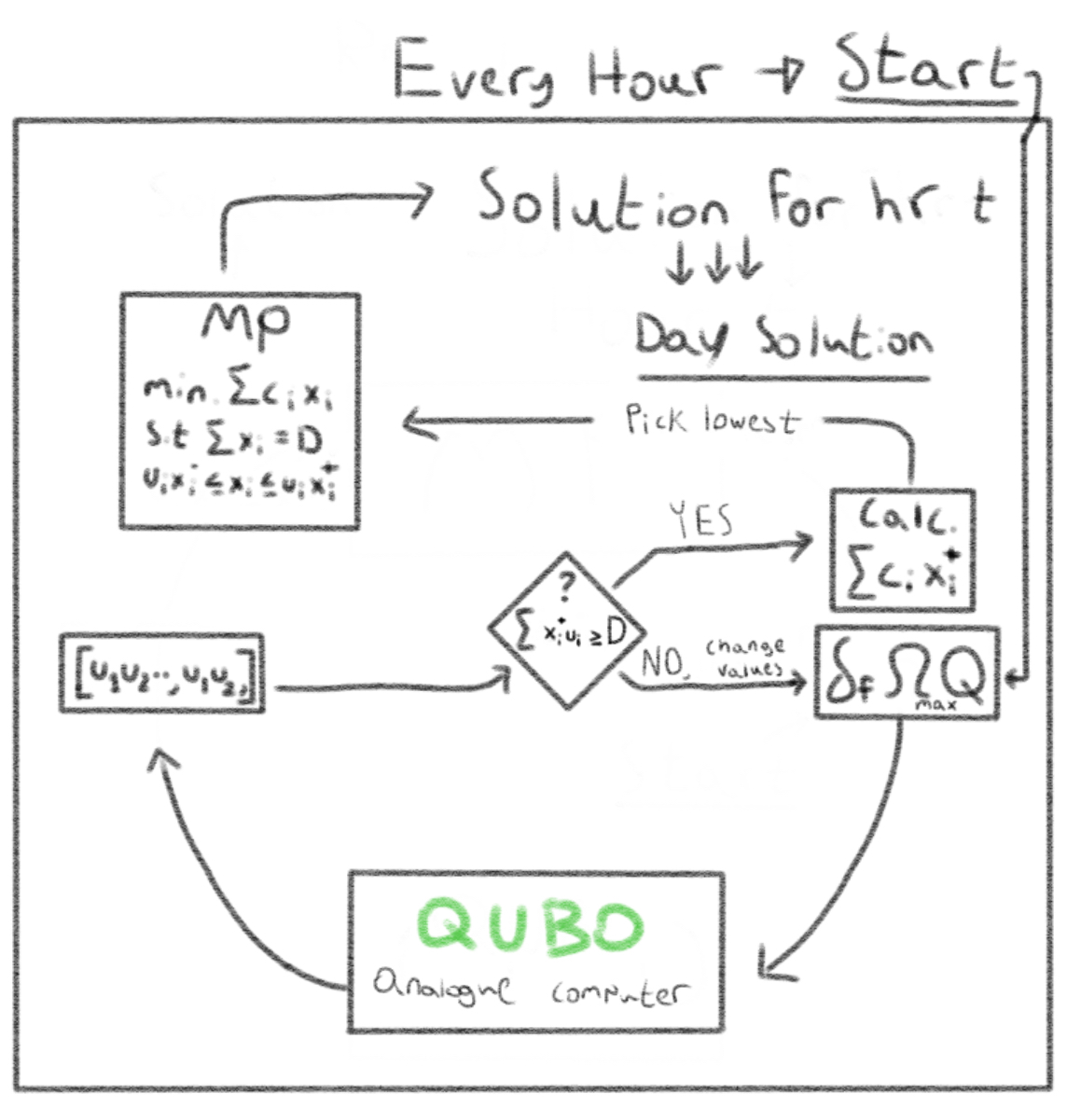
Solution Approach
Pick a Sigma f, Omega-max(default at 4pi) and make a Q matrix based off interactions between providers and our Sigma f
Run the matrix through the QUBO program which will return a distribution of bit-strings.
The program will check the 15 most often bit strings and check for how many meet the demand constraints.
If most of them don't meet the constraints, it'll change the initial values according to how the results need to change and go back to step 1
When the computer gets bit strings from the QUBO that meet the constraints, it'll check for the most cost efficient one(using the max power per provider). That bit string will be a representation of the most optimal on/off status for each provider(at some given tdemand)
It will run the bit string through a classical algorithm that will return the most optimal power per each provider.
It saves this data for that hour and re-runs steps 1-6 every hour for the whole day(changing the demand accordingly)

Slide 11
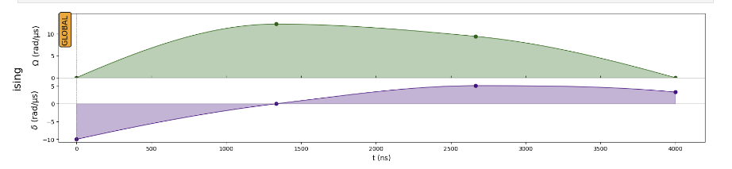
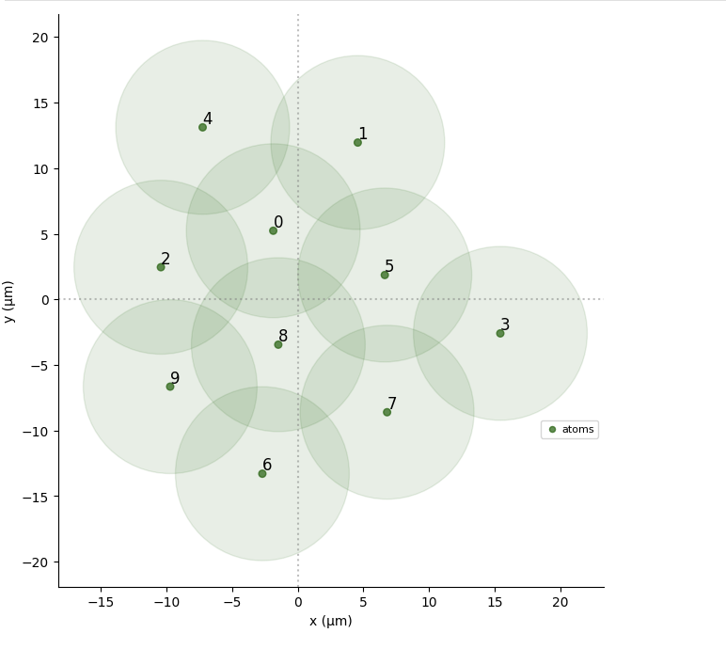
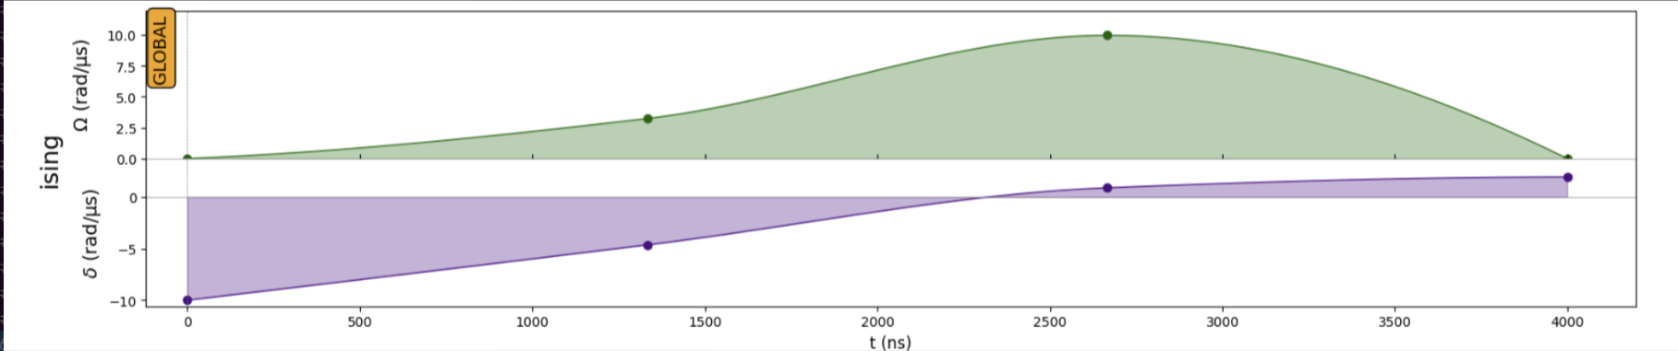
Results

Slide 12
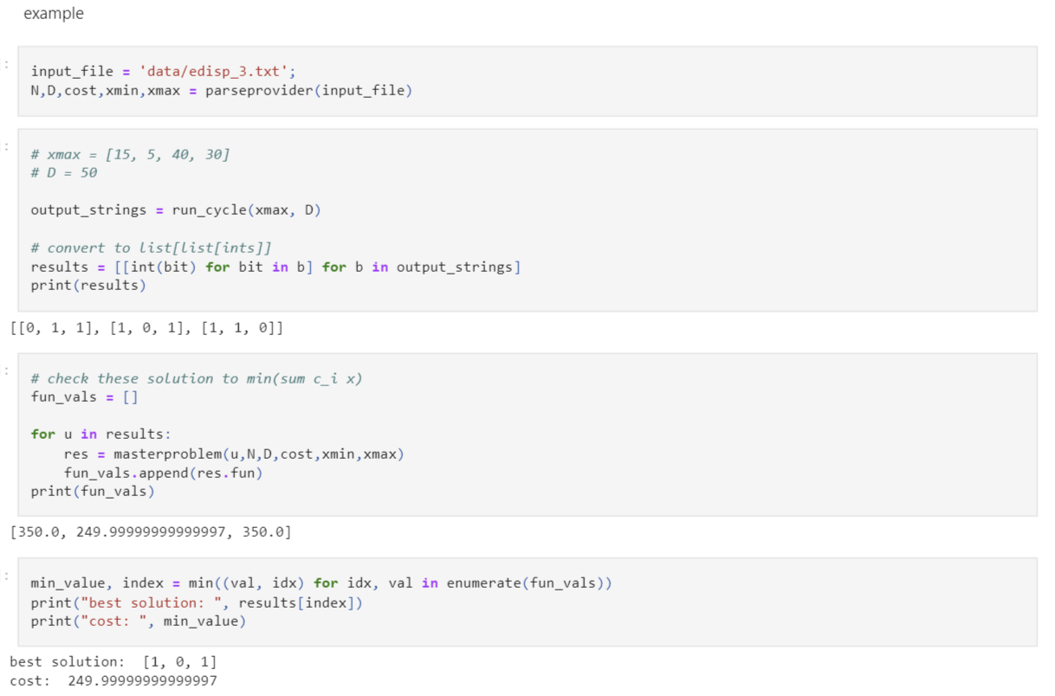
Results
X₁
[0,1]
Demand (D)
X₂
[0,1]
X₃
[0,1]

